Slide 1




ACT: Architectural Carbon Modeling Tools
@ MICRO 2022
Tutorial
Udit Gupta

Slide 2

ACT Tutorial: Today
Time | Topic
1:00 – 1:15pm | Introductory remarks
1:15 – 1:30pm | Motivation: Understanding the source of computing’s emissions
1:30 – 2:15pm | Overview of ACT: An Architectural Carbon Modeling Tool
2:15 –2:30pm | Coffee Break
2:30 – 3:00pm | Hands-on ACT demo’s
3:00 – 3:15pm | Extending ACT
3:15 – 3:45pm | Office Hours
3:45 – 4:00pm | Closing remarks
Notes:
Finally, given our understanding of carbon emissions, we will conclude by charting paths for how to design future sustainable computing systems.

Slide 3
Tackling computing’s carbon footprint requires optimizing emissions across hardware life cycles (manufacturing and operational use)
Notes:
How have these advances affected computing’s overall environmental sustainability and more specifically carbon footprint.

Slide 4
Tackling computing’s carbon footprint requires optimizing emissions across hardware life cycles (manufacturing and operational use)
But (unlike performance, power, energy) there is a distinct lack of architectural tools and infrastructure to quantify carbon
Notes:
How have these advances affected computing’s overall environmental sustainability and more specifically carbon footprint.

Slide 5
Challenge: How do we design sustainable systems by considering the footprint across lifecycles
This work: Architectural Carbon Modeling Tools (ACT)

Slide 6

Challenge: How do we design sustainable systems by considering the footprint across lifecycles
This work: Architectural Carbon Modeling Tools (ACT)
Overview of ACT

Slide 7

Challenge: How do we design sustainable systems by considering the footprint across lifecycles
This work: Architectural Carbon Modeling Tools (ACT)
Overview of ACT
Comparing ACT to other methodologies

Slide 8

Challenge: How do we design sustainable systems by considering the footprint across lifecycles
This work: Architectural Carbon Modeling Tools (ACT)
Overview of ACT
Comparing ACT to other methodologies
Sustainability aware-design case studies

Slide 9
Challenge: How do we design sustainable systems by considering the footprint across lifecycles
This work: Architectural Carbon Modeling Tools (ACT)
Overview of ACT
Comparing ACT to other methodologies
Sustainability aware-design case studies

Slide 10
Architectural Carbon Modeling Tools (ACT)
Arch. Carbon Model
Carbon–aware HW design metrics

Slide 11




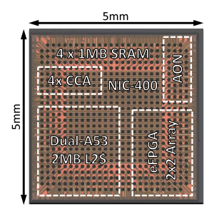
Architectural Carbon Modeling Tools (ACT)
Fab
Environmental
SW design &
performance
Arch. Carbon Model
Carbon–aware HW design metrics
HW design &
power

Slide 12
Architectural Carbon Modeling Tools (ACT)
Fab
Environmental
SW design &
performance
Arch. Carbon Model
Carbon–aware HW design metrics
Operational CO₂
Embodied CO₂
HW design &
power
CO₂ -aware
HW optimization

Slide 13
Architectural Carbon Model
Model
Hardware/software input

Slide 14

Architectural Carbon Model
Model
Hardware/software input
Performance/power/energy and
lifetime of hardware

Slide 15


Architectural Carbon Model
Model
Hardware/software input
Performance/power/energy and
lifetime of hardware
Energy efficiency and
environment (carbon intensity)

Slide 16
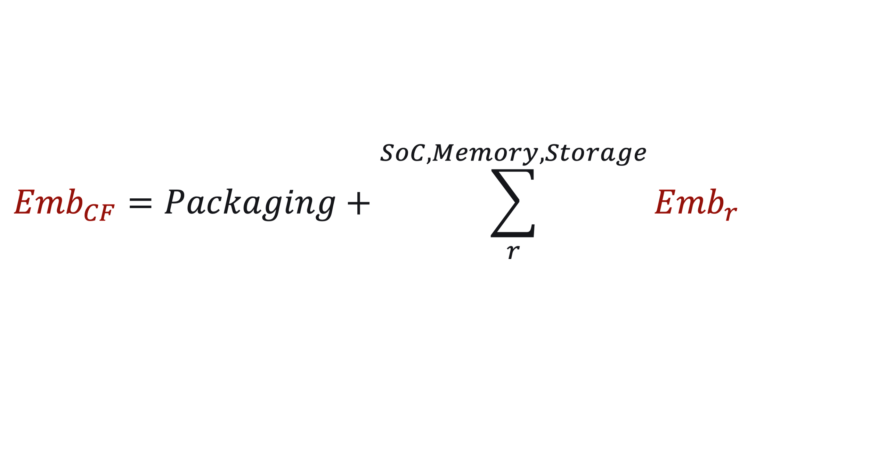
Architectural Carbon Model
Model
Hardware/software input
Performance/power/energy and
lifetime of hardware
Energy efficiency and
environment (carbon intensity)
Overhead of hardware
manufacturing

Slide 17
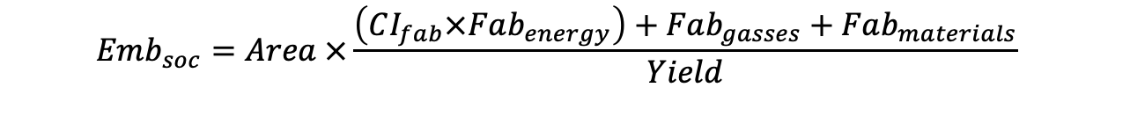
Embodied carbon of application processors (SoC’s)
$$Emb_{soc}=Area ×\frac{\left(CI_{fab}×Fab_{energy}\right)+Fab_{gasses}+Fab_{materials}}{Yield}$$
Notes:
We add the energy, chemicals, and materials used by the fab.
And factor in yield of manufacturing

Slide 18
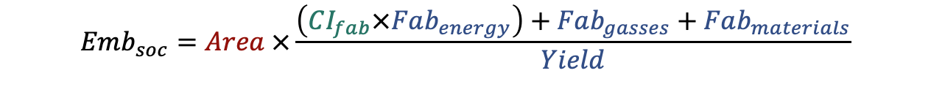
Embodied carbon of application processors (SoC’s)
Energy
source (grid)
Device and fab characterization
(industry fabs, device data)
$$Emb_{soc}=Area ×\frac{\left(CI_{fab}×Fab_{energy}\right)+Fab_{gasses}+Fab_{materials}}{Yield}$$
Hardware design

Slide 19
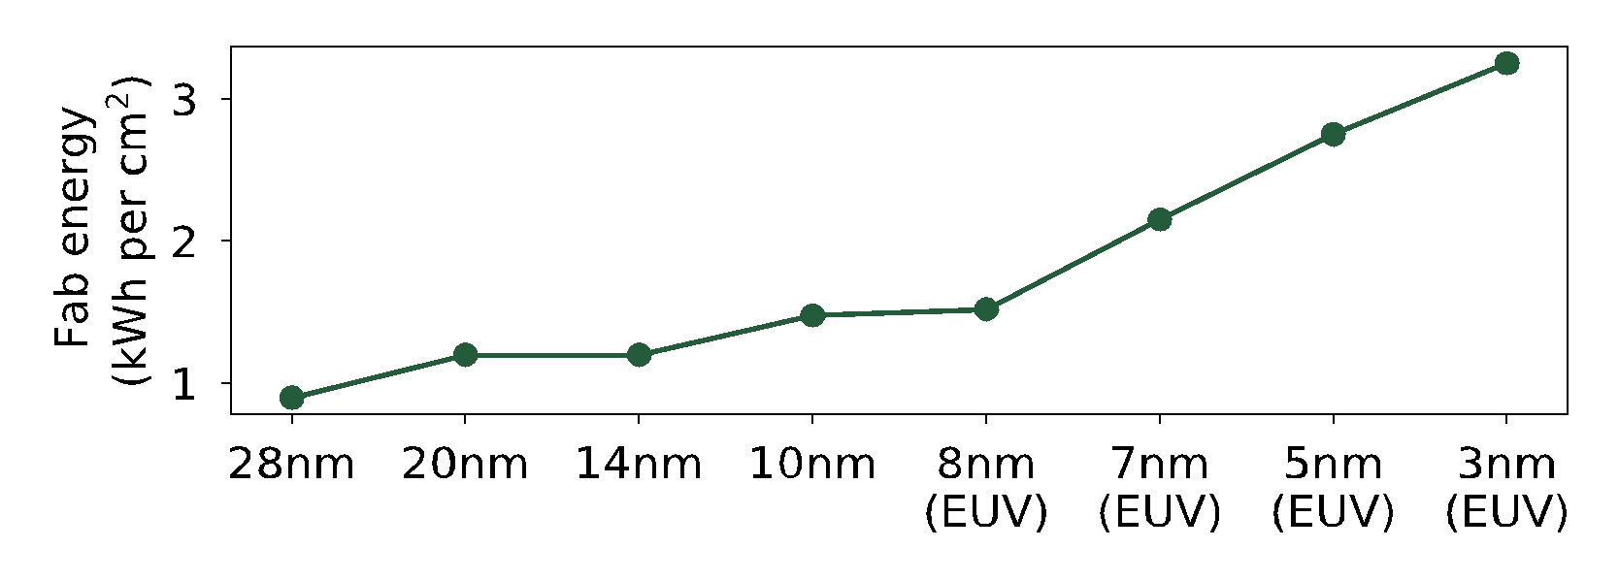
Embodied carbon of application processors (SoC’s)
Fab energy increases over tech. nodes
DTCO including Sustainability: Power-Performance-Area-Cost-Environmental score (PPACE) Analysis for Logic Technologies. Bardon et. al (IEDM 2020)

Slide 20
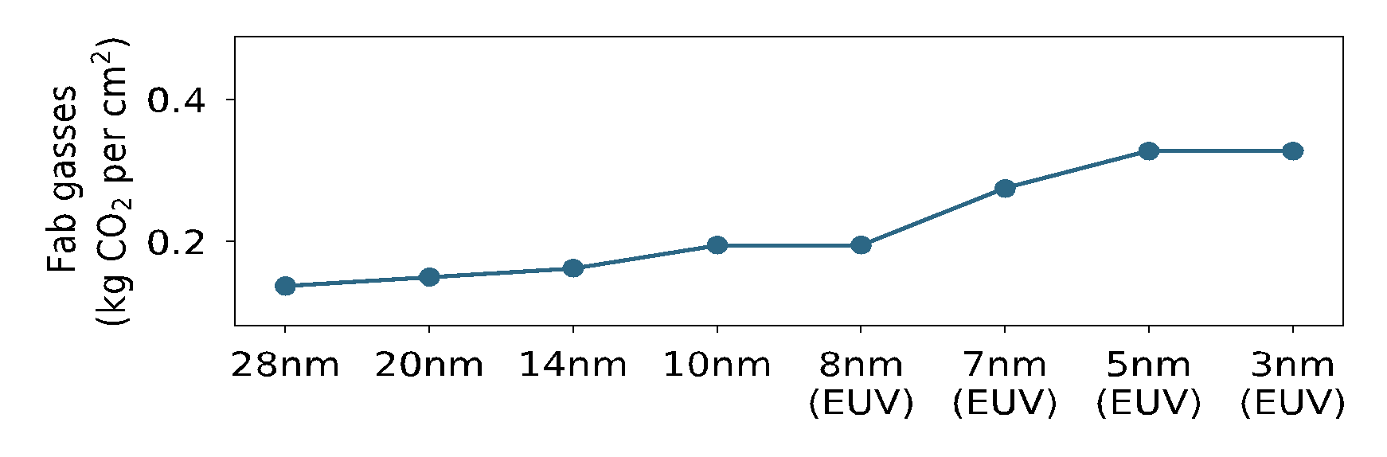
Embodied carbon of application processors (SoC’s)
Fab energy increases over tech. nodes
95% abatement
TSMC (97%)
99% abatement
DTCO including Sustainability: Power-Performance-Area-Cost-Environmental score (PPACE) Analysis for Logic Technologies. Bardon et. al (IEDM 2020)

Slide 21
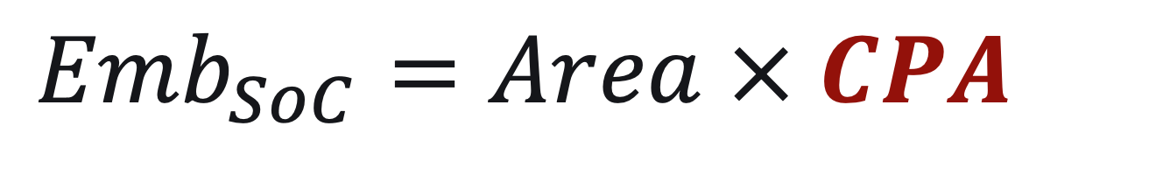
Embodied carbon of application processors (SoC’s)

Slide 22
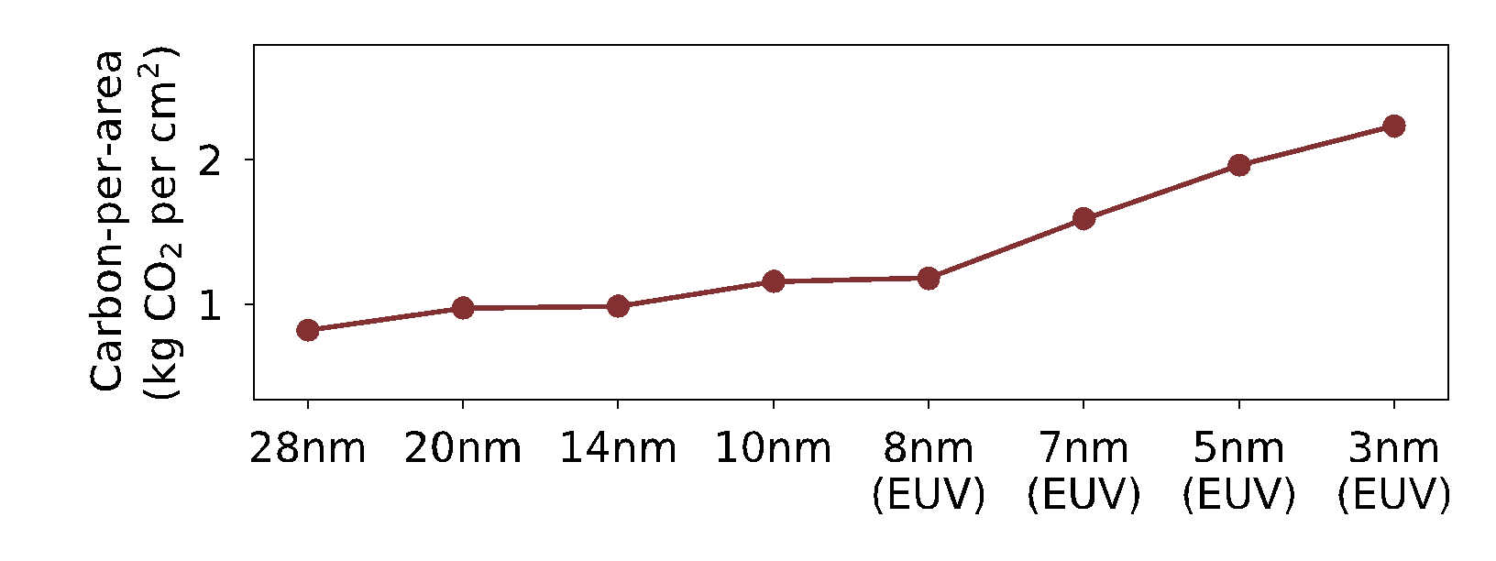
Embodied carbon of application processors (SoC’s)
Data sources:
[IMEC] DTCO including Sustainability: Power-Performance-Area-Cost-Environmental score (PPACE) Analysis for Logic Technologies. Bardon et. al (IEDM 2020)
[TSMC] TSMC Sustainability Reports 2018-2020

Slide 23
Embodied carbon of application processors (SoC’s)
Fab with coal
(0% renewable)
Fab with solar (100% renewable)
Data sources:
[IMEC] DTCO including Sustainability: Power-Performance-Area-Cost-Environmental score (PPACE) Analysis for Logic Technologies. Bardon et. al (IEDM 2020)
[TSMC] TSMC Sustainability Reports 2018-2020

Slide 24
Embodied carbon of application processors (SoC’s)
Fab with coal
(0% renewable)
TSMC 2025 goal
(25% renewable)
Fab with solar (100% renewable)
Data sources:
[IMEC] DTCO including Sustainability: Power-Performance-Area-Cost-Environmental score (PPACE) Analysis for Logic Technologies. Bardon et. al (IEDM 2020)
[TSMC] TSMC Sustainability Reports 2018-2020

Slide 25
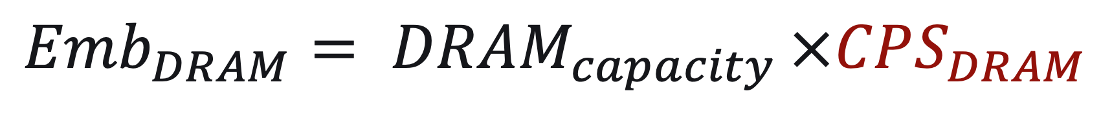
Embodied carbon of DRAM memory
DRAM
from SK Hynix’s sustainability reports

Slide 26

Embodied carbon of NAND Flash storage
NAND
from SK Hynix’s sustainability reports

Slide 27
Embodied carbon of HDD storage
$$Emb_{DRAM}=DRAM_{capacity}×CPS_{DRAM}$$
HDD
from Seagate’s product environmental reports

Slide 28
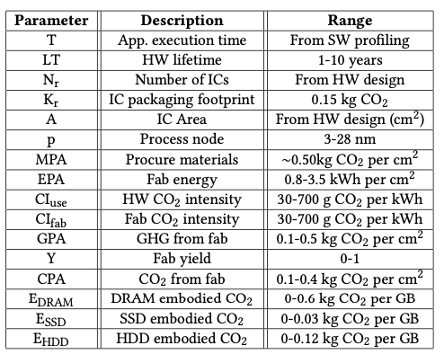
Additional details found in the paper…
ACT parameters
Notes:
We take a similar approach for modeling emissions for memory and storage units which can be found in the paper.

Slide 29
Challenge: How do we design sustainable systems by considering the footprint across lifecycles
This work: Architectural Carbon Modeling Tools (ACT)
Overview of ACT
Comparing ACT to other methodologies
Sustainability aware-design case studies

Slide 30
Current carbon accounting methodologies
 | Description | Limitation
EIO (Economic Input/Output) | A cost-based methodology to translate component price into embodied carbon footprint | Carbon is tied directly to economic cost which is susceptible to various market effects.
Life Cycle Analysis-based tools | A database-based methodology to quantify systems’ embodied emissions | Current databases are out-of-date (45nm or older technology). LCA expert take high $$ and time to conduct new system analysis.
Exergy-based analysis | A methodology based on evaluating the thermodynamic energy in devices | Does not translate directly to carbon emissions. Original exergy analyses are out-of-date.

Slide 31
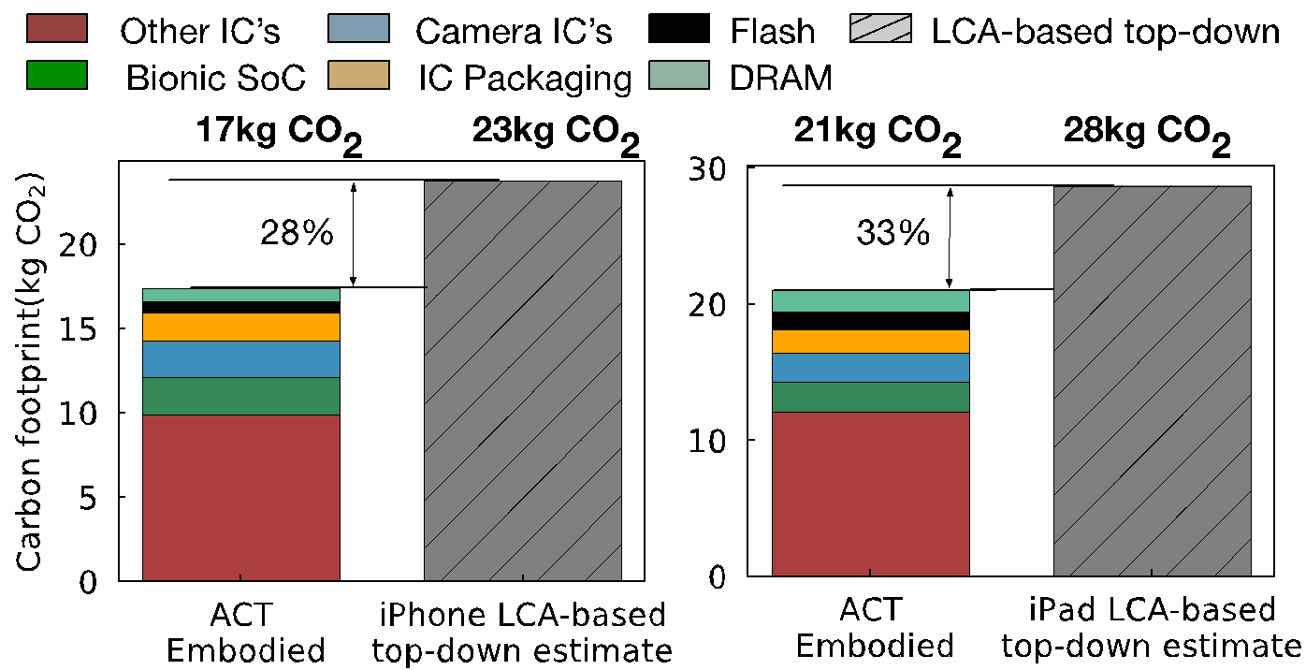
Comparing ACT with Apple’s product environmental reports
ACT embodied
estimate
Apple iPhone
estimates
ACT embodied
estimate
Apple iPad
estimates

Slide 32
Comparing ACT with Apple’s product environmental reports
ACT embodied
estimate
Apple iPhone
estimates
ACT embodied
estimate
Apple iPad
estimates

Slide 33
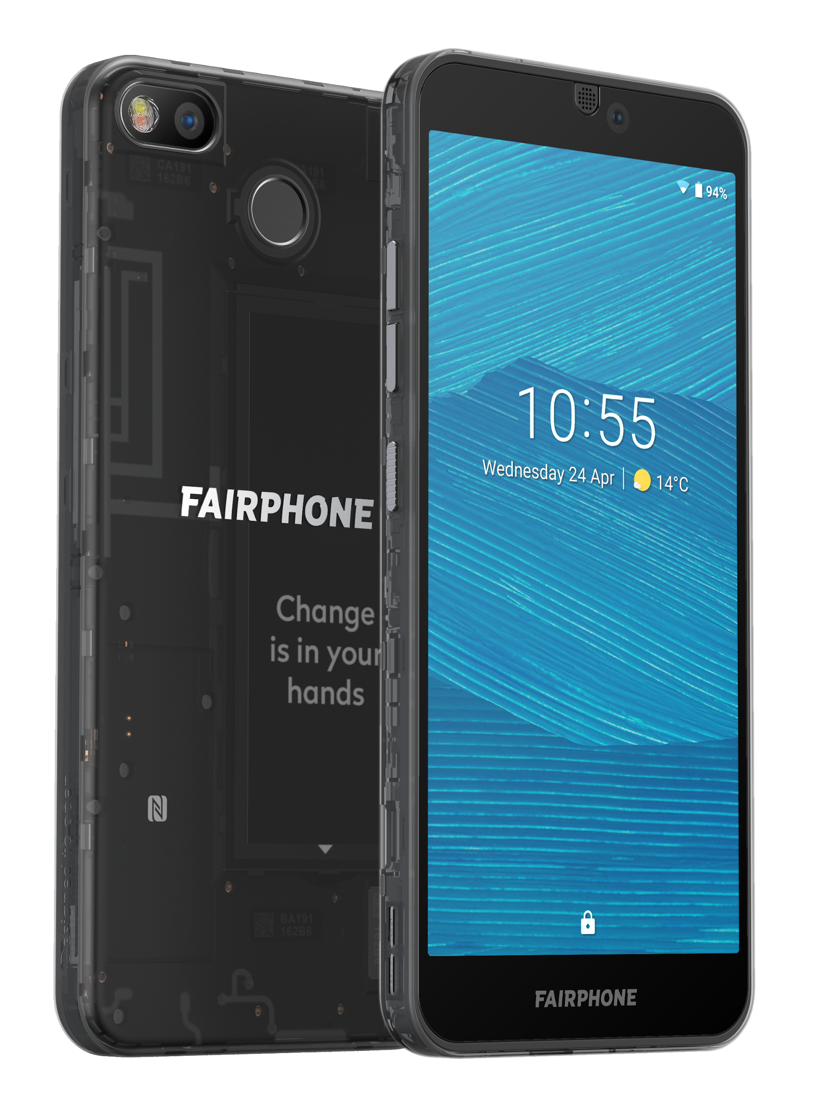
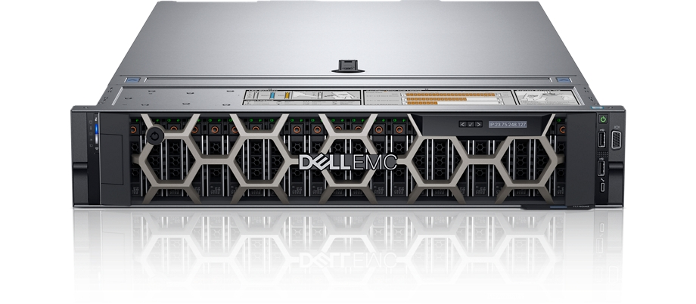
More comparisons (ACT vs. LCA’s) in the paper…
 | ACT vs. Dell R740 server LCA | ACT vs. Fairphone 3 mobile device LCA

Slide 34
More comparisons (ACT vs. LCA’s) in the paper…
IC component | ACT vs. Dell R740 server LCA | ACT vs. Fairphone 3 mobile device LCA
Compute (processors, SoC’s) | Within 2.2x | Within 1.18x
Memory | Within 1.62x | Within 2.1x
Storage | Within 1.05-2.2x
Takeaways
ACT provides first-order approximate of LCA’s that use old technology nodes (45nm NAND, 32nm CPU)
ACT enables architects to study new technology nodes

Slide 35
Challenge: How do we design sustainable systems by considering the footprint across lifecycles
This work: Architectural Carbon Modeling Tools (ACT)
Overview of ACT
Comparing ACT to other methodologies
Sustainability aware-design case studies

Slide 36

Tenets of Environmental Design
Reduce
Design leaner footprint software and hardware.
Recycle
Reuse
Recover discarded systems and components.
Repurpose systems already produce.

Slide 37
Tenets of Environmental Design
Reduce
Design leaner footprint software and hardware.
Recycle
Reuse
Recover discarded systems and components.
Repurpose systems already produce.

Slide 38
Reuse: General purpose versus custom mobile HW
AI inference case study (MobileNet) assuming 3 year hardware lifetime, and same utilization in all cases
Commodity (mobile CPU)
Specialized (mobile GPU, DSP)
Architectural
Carbon Model
Carbon per inference

Slide 39
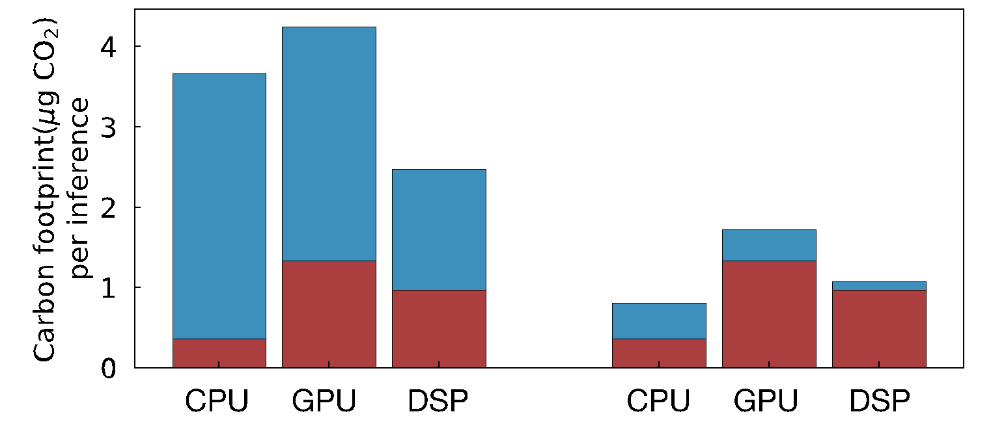
Reuse: General purpose versus custom mobile HW
AI inference case study (MobileNet) assuming 3 year hardware lifetime, and same utilization in all cases
Commodity (mobile CPU)
Specialized (mobile GPU, DSP)
Architectural
Carbon Model
Carbon per inference
Without renewables
during operation
With renewables
during operation

Slide 40
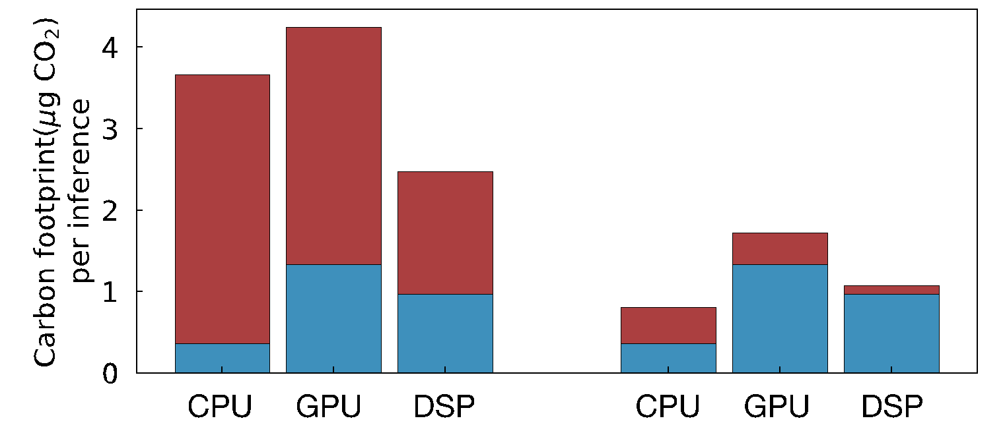
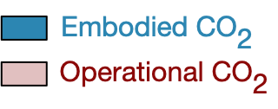
Reuse: General purpose versus custom mobile HW
AI inference case study (MobileNet) assuming 3 year hardware lifetime, and same utilization in all cases
Commodity (mobile CPU)
Specialized (mobile GPU, DSP)
Architectural
Carbon Model
Carbon per inference
DSP
optimal
Without renewables
during operation
With renewables
during operation

Slide 41
Reuse: General purpose versus custom mobile HW
AI inference case study (MobileNet) assuming 3 year hardware lifetime, and same utilization in all cases
Commodity (mobile CPU)
Specialized (mobile GPU, DSP)
Architectural
Carbon Model
Carbon per inference
DSP
optimal
Without renewables
during operation
With renewables
during operation

Slide 42
Reuse: General purpose versus custom mobile HW
AI inference case study (MobileNet) assuming 3 year hardware lifetime, and same utilization in all cases
Commodity (mobile CPU)
Specialized (mobile GPU, DSP)
Architectural
Carbon Model
Carbon per inference
DSP
optimal
CPU
optimal
3x reduction
Without renewables
during operation
With renewables
during operation

Slide 43
Reuse: General purpose versus custom mobile HW
AI inference case study (MobileNet) assuming 3 year hardware lifetime, and same utilization in all cases
Commodity (mobile CPU)
Specialized (mobile GPU, DSP)
Architectural
Carbon Model
Carbon per inference
CPU optimal
CPU
GPU
DSP
CPU
GPU
DSP
CPU
GPU
DSP
CPU
GPU
DSP
Coal
Taiwan
Renewable
Carbon-free
Carbon intensity of semiconductor fabs

Slide 44
Reuse: General purpose versus custom mobile HW
AI inference case study (MobileNet) assuming 3 year hardware lifetime, and same utilization in all cases
Commodity (mobile CPU)
Specialized (mobile GPU, DSP)
Architectural
Carbon Model
Carbon per inference
CPU optimal
CPU
GPU
DSP
CPU
GPU
DSP
CPU
GPU
DSP
CPU
GPU
DSP
Coal
Taiwan
Renewable
Carbon-free
Carbon intensity of semiconductor fabs

Slide 45
Reuse: General purpose versus custom mobile HW
AI inference case study (MobileNet) assuming 3 year hardware lifetime, and same utilization in all cases
Commodity (mobile CPU)
Specialized (mobile GPU, DSP)
Architectural
Carbon Model
Carbon per inference
CPU optimal
CPU optimal
DSP optimal
CPU
GPU
DSP
CPU
GPU
DSP
CPU
GPU
DSP
CPU
GPU
DSP
Coal
Taiwan
Renewable
Carbon-free
Carbon intensity of semiconductor fabs

Slide 46
Reuse: General purpose versus custom mobile HW
AI inference case study (MobileNet) assuming 3 year hardware lifetime, and same utilization in all cases
Commodity (mobile CPU)
Specialized (mobile GPU, DSP)
Architectural
Carbon Model
Carbon per inference
CPU optimal
CPU optimal
DSP optimal
DSP optimal
CPU
GPU
DSP
CPU
GPU
DSP
CPU
GPU
DSP
CPU
GPU
DSP
Coal
Taiwan
Renewable
Carbon-free
Carbon intensity of semiconductor fabs

Slide 47
Tenets of Environmental Design
Reduce
Design leaner footprint software and hardware.
Recycle
Reuse
Recover discarded systems and components.
Repurpose systems already produce.

Slide 48
Reduce: Designing leaner hardware systems
Architectural
Carbon Model
Performance/energy vs.
Carbon
Nvidia DL Accelerator (NVDLA)

Slide 49
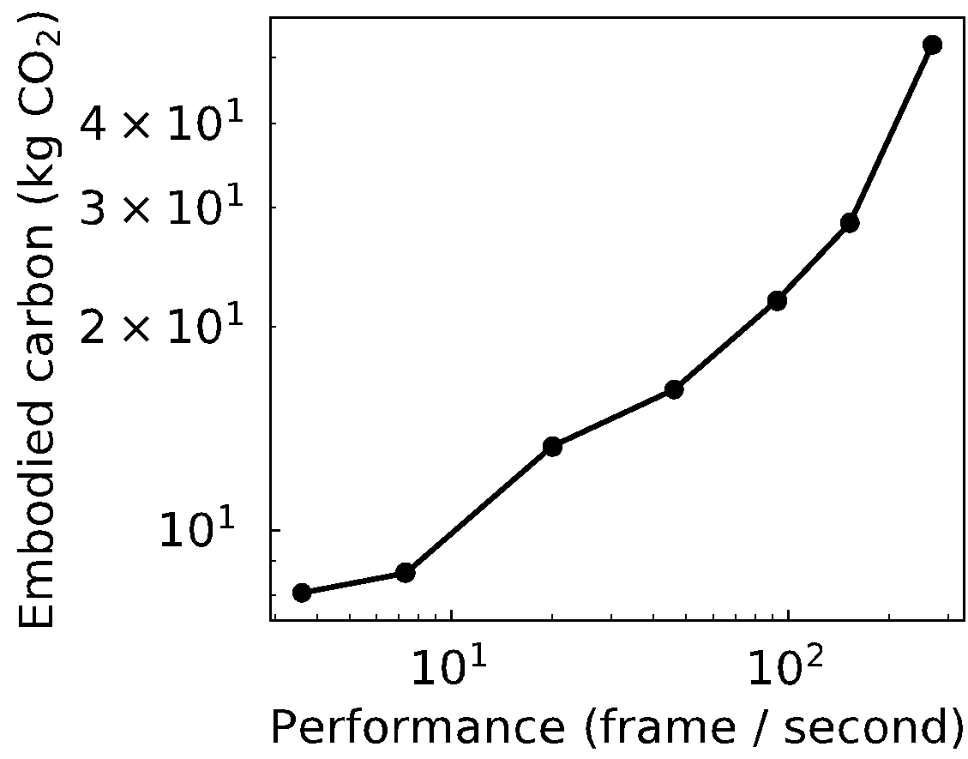
Reduce: Designing leaner hardware systems
Architectural
Carbon Model
Performance/energy vs.
Carbon
Nvidia DL Accelerator (NVDLA)
30 FPS target
30 FPS target

Slide 50
Reduce: Designing leaner hardware systems
Architectural
Carbon Model
Performance/energy vs.
Carbon
Nvidia DL Accelerator (NVDLA)
30 FPS target

Slide 51
Reduce: Designing leaner hardware systems
Architectural
Carbon Model
Performance/energy vs.
Carbon
Nvidia DL Accelerator (NVDLA)
Performance
opt.
Energy
opt.
30 FPS target

Slide 52
Reduce: Designing leaner hardware systems
Architectural
Carbon Model
Performance/energy vs.
Carbon
Nvidia DL Accelerator (NVDLA)
Performance
opt.
3x carbon decrease!
CO₂ opt.
Energy
opt.
30 FPS target

Slide 53
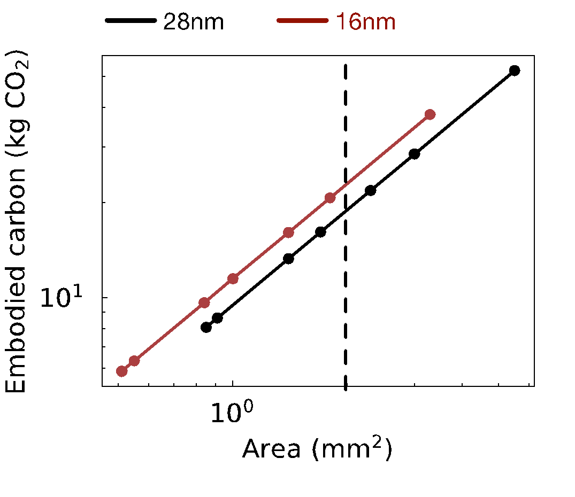
Reduce: Designing leaner hardware systems
Architectural
Carbon Model
Performance/energy vs.
Carbon
Nvidia DL Accelerator (NVDLA)
Performance
opt.
3x carbon decrease!
CO₂ opt.
Energy
opt.
30 FPS target
2mm² area

Slide 54
Reduce: Designing leaner hardware systems
Architectural
Carbon Model
Performance/energy vs.
Carbon
Nvidia DL Accelerator (NVDLA)
Performance
opt.
3x carbon decrease!
CO₂ opt.
Energy
opt.
30 FPS target
2mm² area

Slide 55
Reduce: Designing leaner hardware systems
Architectural
Carbon Model
Performance/energy vs.
Carbon
Nvidia DL Accelerator (NVDLA)
Performance
opt.
30% carbon increase
(Jevon’s paradox)
3x carbon decrease!
CO₂ opt.
Energy
opt.
30 FPS target
2mm² area

Slide 56
Tenets of Environmental Design
Reduce
Design leaner footprint software and hardware.
Recycle
Reuse
Recover discarded systems and components.
Repurpose systems already produce.

Slide 57
Recycle: Extending hardware lifetime
Mobile SoC’s
Geekbench characterization
Architectural
Carbon Model
Operational vs.
Embodied carbon

Slide 58
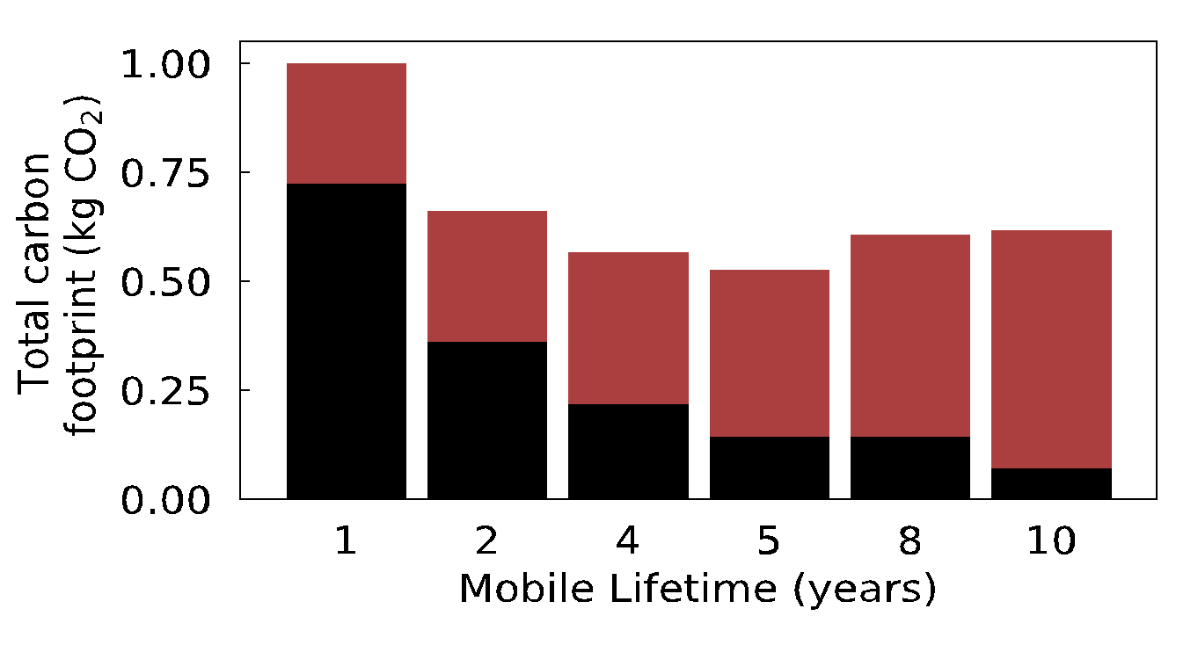
Recycle: Extending hardware lifetime
Mobile SoC’s
Geekbench characterization
Architectural
Carbon Model
Operational vs.
Embodied carbon
Embodied CO₂
Operational CO₂

Slide 59
Recycle: Extending hardware lifetime
Mobile SoC’s
Geekbench characterization
Architectural
Carbon Model
Operational vs.
Embodied carbon
Embodied CO₂
Operational CO₂
Embodied
reduction
Operational
degradation

Slide 60
Recycle: Extending hardware lifetime
Mobile SoC’s
Geekbench characterization
Architectural
Carbon Model
Operational vs.
Embodied carbon
Embodied CO₂
Operational CO₂
Embodied
reduction
Operational
degradation
Enabling 2nd life
requires enhancing
HW reliability
See paper for case
study on storage
reliability using
SSD overprovisioning

Slide 61
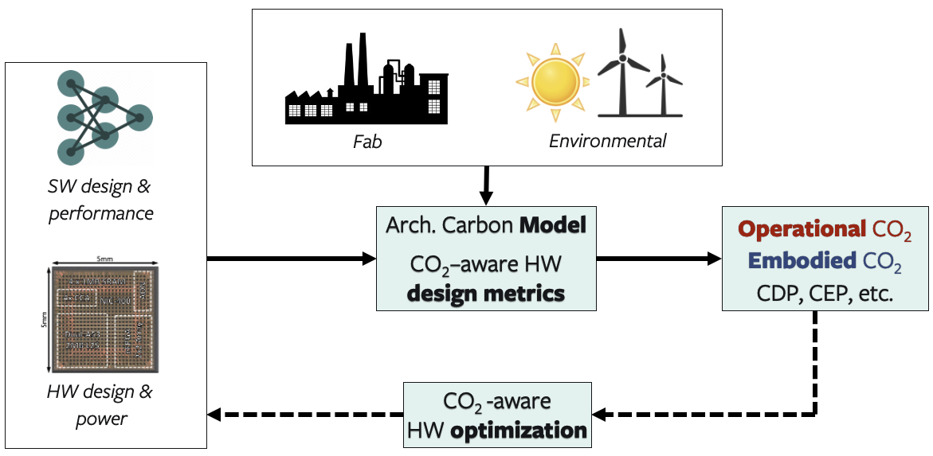
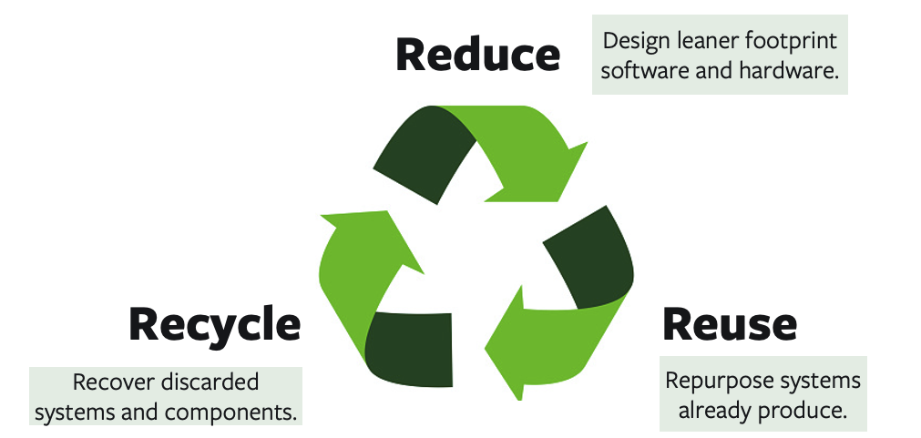
This work: ACT
Develop the model
Case studies

Slide 62
This work: ACT
Develop the model
Case studies
More details in the paper!
Modeling parameters and industry sources for data
Carbon-aware metrics for early DSE (e.g., EDP, CDP, CEP)
Detailed comparison against industry LCA’s
Reuse case study: impact of reconfigurable accelerators (FPGA’s)
Recycle case study: Enabling second life & SSD provisioning

Slide 63
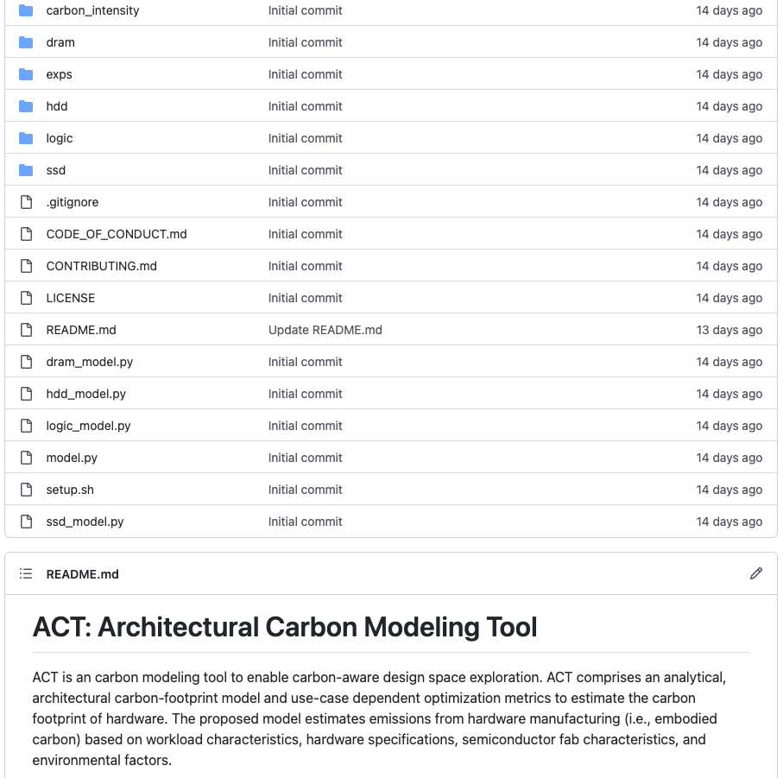

This work: ACT
Develop the model
Case studies
Open-source!
More details in the paper!
Modeling parameters and industry sources for data
Carbon-aware metrics for early DSE (e.g., EDP, CDP, CEP)
Detailed comparison against industry LCA’s
Reuse case study: impact of reconfigurable accelerators (FPGA’s)
Recycle case study: Enabling second life & SSD provisioning

Slide 64
Thank you!
This work: ACT
Develop the model
Case studies
Open-source!
More details in the paper!
Modeling parameters and industry sources for data
Carbon-aware metrics for early DSE (e.g., EDP, CDP, CEP)
Detailed comparison against industry LCA’s
Reuse case study: impact of reconfigurable accelerators (FPGA’s)
Recycle case study: SSD provisioning

Slide 65
ACT Tutorial: Today
Time | Topic
1:00 – 1:15pm | Introductory remarks
1:15 – 1:30pm | Motivation: Understanding the source of computing’s emissions
1:30 – 2:15pm | Overview of ACT: An Architectural Carbon Modeling Tool
2:15 –2:30pm | Coffee Break
2:30 – 3:00pm | Hands-on ACT demo’s
3:00 – 3:15pm | Extending ACT
3:15 – 3:45pm | Office Hours
3:45 – 4:00pm | Closing remarks
Notes:
Finally, given our understanding of carbon emissions, we will conclude by charting paths for how to design future sustainable computing systems.

